Slide 1
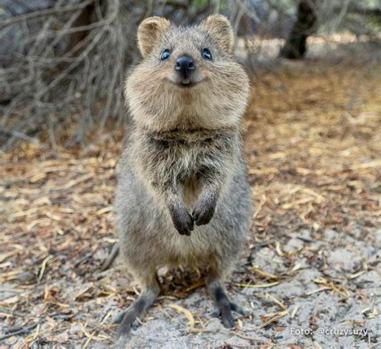
WA Ecosystem – Page 1
Western Australia is home to a stunningly diverse range of animals and plants, forming a complex and dynamic ecosystem. Spanning a land area that is vast and varied, this region hosts many species that are found nowhere else on Earth. The southwest corner of the state, for instance, is one of the most biodiverse places on the planet. Here, you can find more than 12,000 species of wildflowers, making it the world's largest collection of wildflowers. This rich flora provides food and habitat for a myriad of animal species.
Is Western Australia’s ecosystem diverse or not? ___________________________________________________________________
In which part of Western Australia is most of the biodiversity concentrated? ___________________________________________________________________
How many species of wildflowers are found in the southwest corner of Western Australia? ___________________________________________________________________
Among the wild creatures of Western Australia, marsupials like kangaroos and quokkas are quite iconic. These animals are unique in their reproduction process, as their young are born very undeveloped and often continue growing in a pouch on the mother's body. There's also an array of fascinating bird species, such as the black swan, which is the state bird, and the Carnaby's black cockatoo, which is threatened and found only in the southwest.
Name two marsupials that can be found in Western Australia. ___________________________________________________________________
Which bird is the state bird of Western Australia? ___________________________________________________________________
In which part of Western Australia can the Carnaby’s black cockatoo be found? ___________________________________________________________________

Slide 2
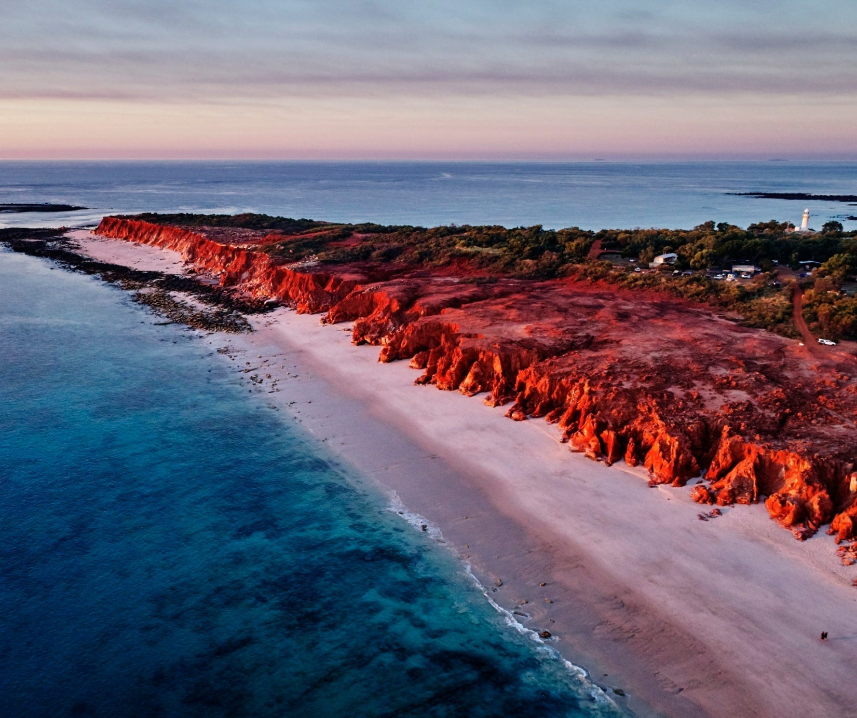
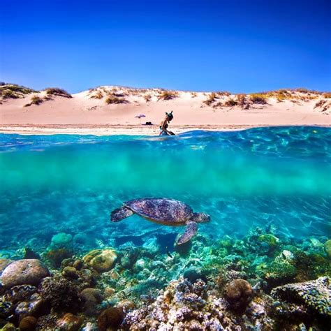
WA Ecosystem – Page 2
In contrast to the lush southwest, the central and northern parts of Western Australia consist mostly of dry deserts and grasslands. Here, you will find animals adapted to survive the harsh, dry conditions, such as the thorny devil lizard, which can drink water through its skin, and the red kangaroo, the largest marsupial in the world, that has adapted to survive in these harsh environments. Many species of snakes and scorpions also make these arid regions their home.
What type of environment is found in the central and northern parts of Western Australia? __________________________________________________________________
Name two animals that have adapted to survive in these conditions. __________________________________________________________________
Which is the largest marsupial in the world? __________________________________________________________________
Western Australia also hosts a diverse marine ecosystem. The Ningaloo Reef, for example, is a World Heritage Site and the world's largest fringing coral reef. It hosts more than 500 species of tropical fish, and diverse species of coral. The reef is also known for the annual migration of whale sharks, the largest fish in the world. Dolphins, manta rays, and humpback whales are other marine creatures that inhabit the waters of Western Australia.
Why is the Ningaloo Reef special? __________________________________________________________________
Besides whale sharks, name 3 other marine creatures found in the waters of Western Australia.

